Slide 1
Web fundamentals Introduction
Milan Ojsteršek
Sandi Majninger

Slide 2
Objectives
The objective of this course is to acquaint students with usage of basic services on the internet and to teach them how to design, implement and test simple Web pages, written in HTML, CSS, Javascript, JQuery and PHP.

Slide 3
Syllabus
Introduction: history of the internet, internet services, searching on the Web, internet traps.
HTML: basic tags, tables, frames, lists, forms, clickable maps, backgrounds, multimedia content, XHTML, HTML5, search engine optimisation.
Web design basics, colors, CSS and CSS3, responsive web design.
JavaScript: control structures and operators, functions, basic objects (Array, Boolean, Date, Math, String, HTML DOM objects), AJAX, JQuery.
PHP: control structures and operators, data types, arrays, functions.
Microformats. HTML5 microdata, XML, RDFa, SVG.
Introduction to Web technologies.

Slide 4
Lecture materials
E študij UM: https://estudij.um.si/
W3Schools: http://www.w3schools.com
Wikipedia: https://en.wikipedia.org/wiki/Main_Page
W3C: https://www.w3.org/
Other sources on the internet

Slide 5
Assesment
Lab work are 50 % of a mark. Positive lab works are 25%.
Midterm written exams:
1st midterm written exam 25% ( minimal 8,75 %)
2nd midterm written exam 25 % (minimal 8,75 %)
Midterm written exams are 50 %. If a student has not completed midterm exams with minimal 25%, he replaces them with a written exam in the weight of 50%.

Slide 6
Midterm written exams
1st midterm written exam 27. 11 at 8 am G3 1-13
2nd midterm written exam 22. 1. at 8 am G3 1-13.

Slide 7
Important terms
Data- factual information (such as measurements or statistics) used as a basic for reasoning, discussion or calculation. -information in digital form that can be transmitted or processed
Information-the communication or reception of knowledge or intelligence
-knowledge obtained from investigation, study or instruction
Information System –an integrated set of components for collecting, storing, and processing data for providing information, knowledge and digital products.(5 components)
Knowledge-Facts, information, and skills acquired through experience or education; the theoretical or practical understanding of a subject.
- combination of data, information, experience, and individual interpretation.
Internet-The internet is the wider network that allows computer networks around the world run by companies, governments, universities and other organisations to talk to one another. The result is a mass of cables, computers, data centres, routers, servers, repeaters, satellites and wifi towers that allows digital information to travel around the world.-The Internet is the global system of interconnected computer networks that use the Internet protocol suite (TCP/IP) to link devices worldwide. It is a network of networks that consists of private, public, academic, business, and government networks of local to global scope, linked by a broad array of electronic, wireless, and optical networking technologies. The Internet carries a vast range of information resources and services, such as the inter-linked hypertext documents and applications of the World Wide Web (WWW), electronic mail, telephony, and file sharing.
Intranet-is a private network accessible only to an organization's staff.[1][2] Often, a wide range of information and services are available on an organization's internal intranet that are unavailable to the public, unlike the Internet. Increasingly, intranets are being used to deliver tools, e.g. collaboration (to facilitate working in groups and teleconferencing) or sophisticated corporate directories, sales and customer relationship management tools, project management etc., to advance productivity.
Extranet- is a private network that uses Internet technology and the public telecommunication system to securely share part of a business's information or operations with suppliers, vendors, partners, customers, or other businesses. An extranet can be viewed as part of a company's intranet that is extended to users outside the company. It has also been described as a "state of mind" in which the Internet is perceived as a way to do business with other companies as well as to sell products to customers.

Slide 8



















Internet
PC
millions of connected computing devices:
hosts = end systems
running network apps
mobile network
server
wireless
laptop
global ISP
smartphone
home
network
communication links
fiber, copper, radio, satellite
transmission rate: bandwidth
regional ISP
wireless
links
wired
links
Packet switches: forward packets (chunks of data)
routers and switches
router
institutional
network
Notes:
8

Slide 9

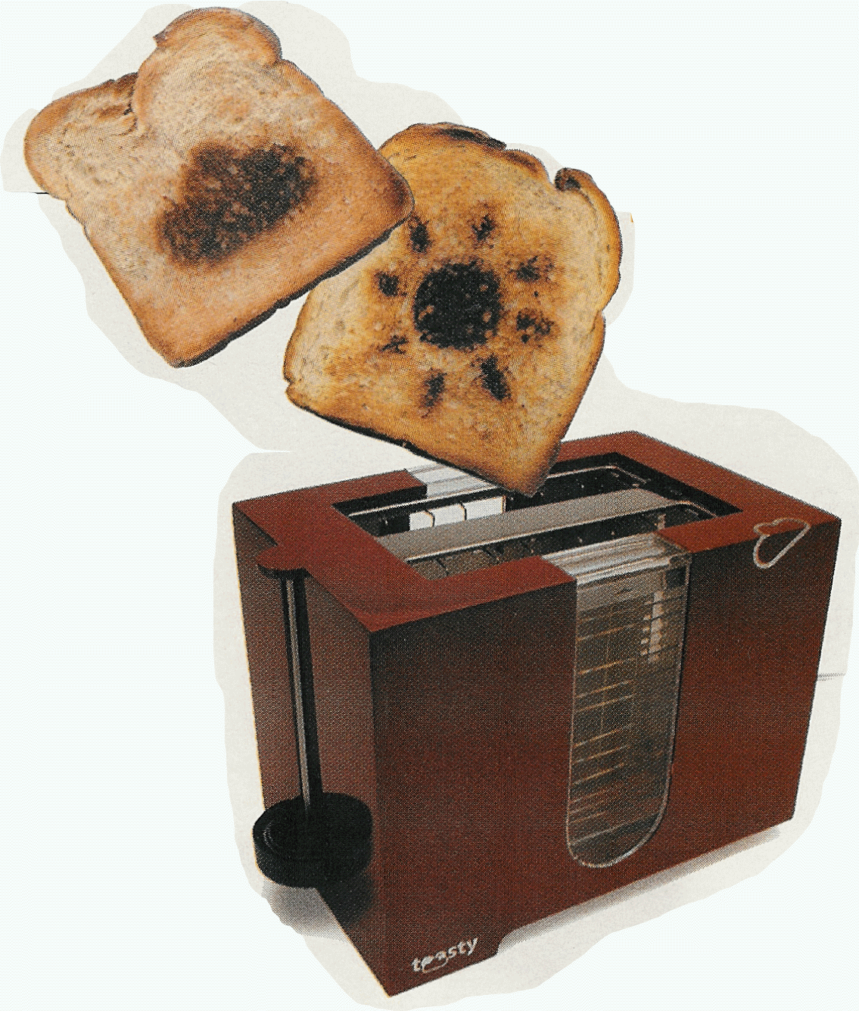


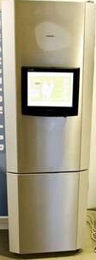
“Fun” internet appliances
Web-enabled toaster +
weather forecaster
IP picture frame
http://www.ceiva.com/
Tweet-a-watt:
monitor energy use
Slingbox: watch,
control cable TV remotely
Internet
refrigerator
Internet phones

Slide 10
What’s the Internet: “nuts and bolts” view
Internet: “network of networks”
Interconnected ISPs
protocols control sending, receiving of msgs
e.g., TCP, IP, HTTP, Skype, 802.11
Internet standards
RFC: Request for comments
IETF: Internet Engineering Task Force
mobile network
global ISP
home
network
regional ISP
institutional
network

Slide 11
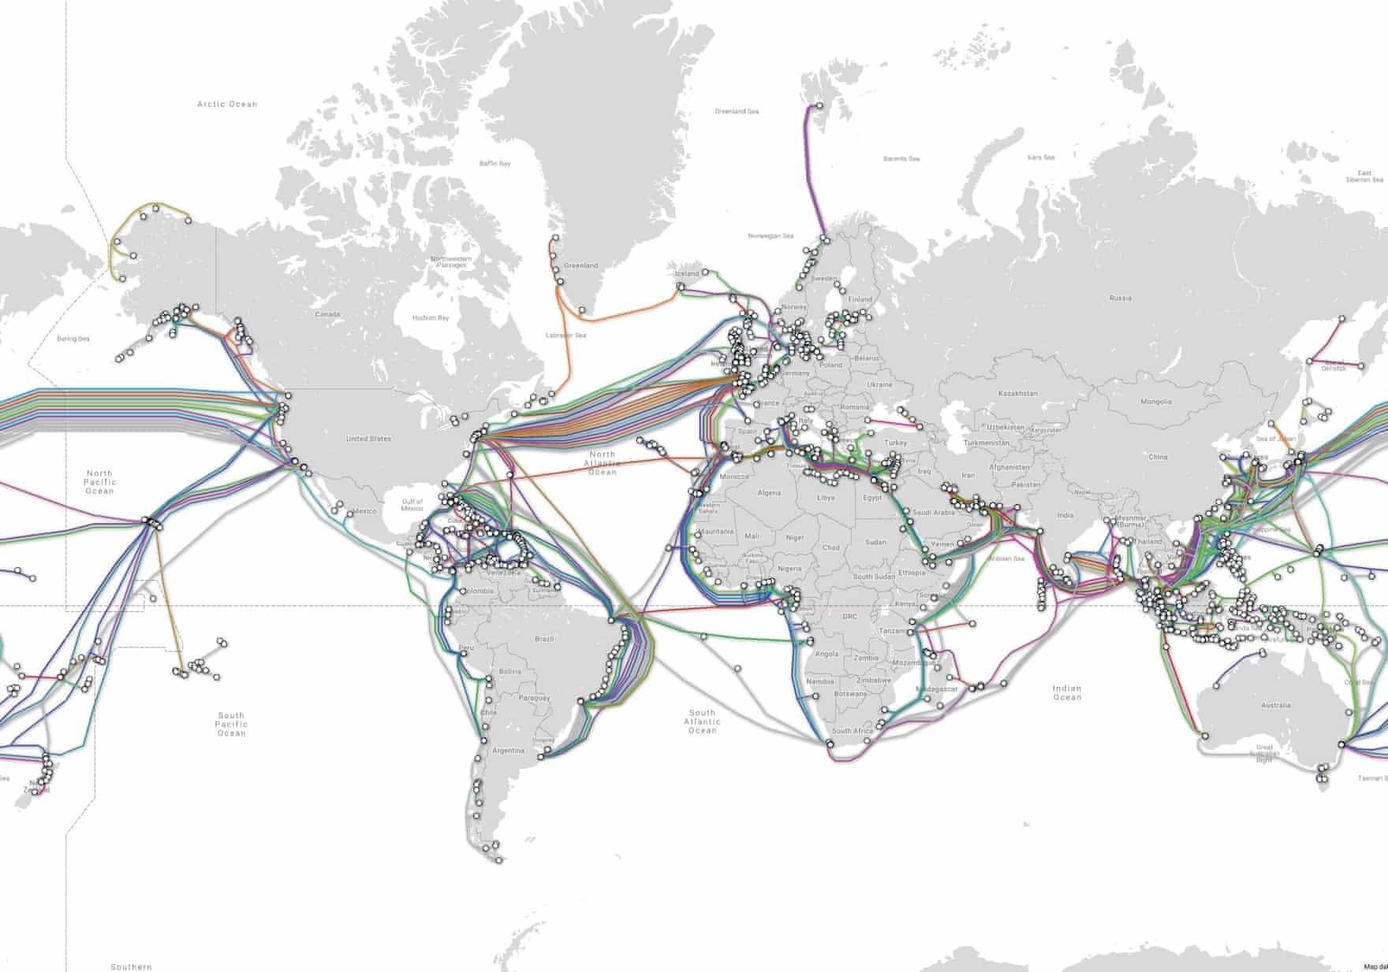
How big is the internet?
One measure is the amount of information that courses through it: about five exabytes a day. That’s equivalent to 40,000 two-hour standard definition movies per second.
It takes some wiring up. Hundreds of thousands of miles of cables criss-cross countries, and more are laid along sea floors to connect islands and continents. About 300 submarine cables, the deep-sea variant only as thick as a garden hose, underpin the modern internet. Most are bundles of hair-thin fibre optics that carry data at the speed of light.

Slide 12
What is the world wide web?
The web is a way to view and share information over the internet. That information, be it text, music, photos or videos or whatever, is written on web pages served up by a web browser.
Google handles more than 40,000 searches per second, and has 60% of the global browser market through Chrome. There are nearly 2bn websites in existence but most are hardly visited. The top 0.1% of websites (roughly 5m) attract more than half of the world’s web traffic.
Among them are Google, YouTube, Facebook, the Chinese site Baidu, Instagram, Yahoo, Twitter, the Russian social network VK.com, Wikipedia, Amazon. The rise of apps means that for many people, being on the internet today is less about browsing the open web than getting more focused information: news, messages, weather forecasts, videos and the like.

Slide 13
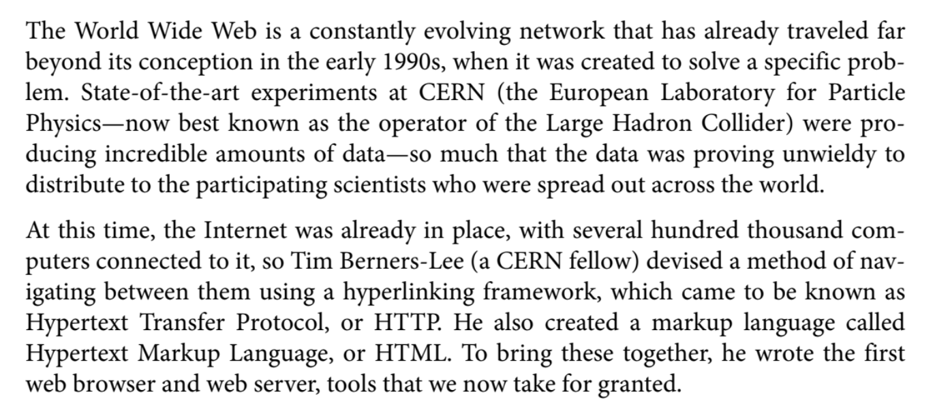

Slide 14
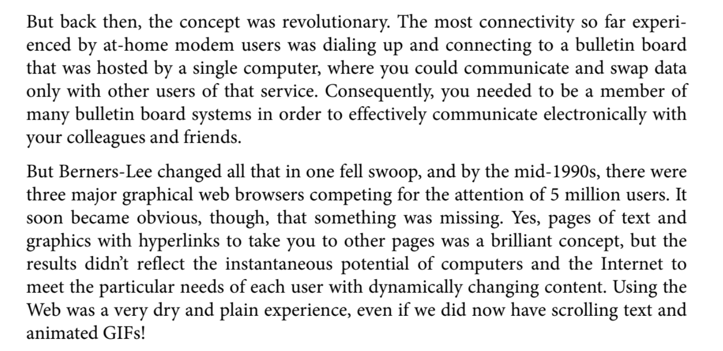

Slide 15
What’s the Internet: a service view
mobile network
Infrastructure that provides services to applications:
Web, VoIP, email, games, e-commerce, social nets, …
provides programming interface to apps
hooks that allow sending and receiving app programs to “connect” to Internet
provides service options, analogous to postal service
global ISP
home
network
regional ISP
institutional
network

Slide 16


A closer look at network structure:
network edge:
hosts: clients and servers
servers often in data centers
mobile network
global ISP
access networks, physical media: wired, wireless communication links
home
network
regional ISP
network core:
interconnected routers
network of networks
institutional
network

Slide 17






Access net: home network
wireless
devices
to/from headend or central office
often combined
in single box
cable or DSL modem
wireless access
point (54 Mbps)
router, firewall, NAT
wired Ethernet (100 Mbps)

Slide 18









Enterprise access networks (Ethernet)
institutional link to
ISP (Internet)
institutional router
Ethernet
switch
institutional mail,
web servers
typically used in companies, universities, etc
10 Mbps, 100Mbps, 1Gbps, 10Gbps transmission rates
today, end systems typically connect into Ethernet switch

Slide 19








Wireless access networks
shared wireless access network connects end system to router
via base station aka “access point”
wide-area wireless access
provided by telco (cellular) operator, 10’s km
between 1 and 10 Mbps
3G, 4G: LTE
wireless LANs:
within building
802.11b/g (WiFi): 11, 54 Mbps transmission rate
to Internet
to Internet

Slide 20


What’s a protocol?
a human protocol and a computer network protocol:
Hi
TCP connection
request
Hi
TCP connection
response
Got the
time?
Get http://www.awl.com/kurose-ross
2:00
<file>
time
Q: other human protocols?

Slide 21
The Internet Protocol (IP) is the method or protocol by which data is sent from one computer to another on the Internet. Each computer (known as a host) on the Internet has at least one IP address that uniquely identifies it from all other computers on the Internet. When you send or receive data (for example, an e-mail note or a Web page), the message gets divided into little chunks called packets. Each of these packets contains both the sender's Internet address and the receiver's address. Any packet is sent first to a gateway computer that understands a small part of the Internet. The gateway computer reads the destination address and forwards the packet to an adjacent gateway that in turn reads the destination address and so forth across the Internet until one gateway recognizes the packet as belonging to a computer within its immediate neighborhood or domain. That gateway then forwards the packet directly to the computer whose address is specified.
Because a message is divided into a number of packets, each packet can, if necessary, be sent by a different route across the Internet. Packets can arrive in a different order than the order they were sent in. The Internet Protocol just delivers them. It's up to another protocol, the Transmission Control Protocol (TCP) to put them back in the right order.
IP is a connectionless protocol, which means that there is no continuing connection between the end points that are communicating. Each packet that travels through the Internet is treated as an independent unit of data without any relation to any other unit of data. (The reason the packets do get put in the right order is because of TCP, the connection-oriented protocol that keeps track of the packet sequence in a message.) In the Open Systems Interconnection (OSI) communication model, IP is in layer 3, the Networking Layer.
The most widely used version of IP today is Internet Protocol Version 4 (IPv4). However, IP Version 6 (IPv6) is also beginning to be supported. IPv6 provides for much longer addresses and therefore for the possibility of many more Internet users. IPv6 includes the capabilities of IPv4 and any server that can support IPv6 packets can also support IPv4 packets.

Slide 22
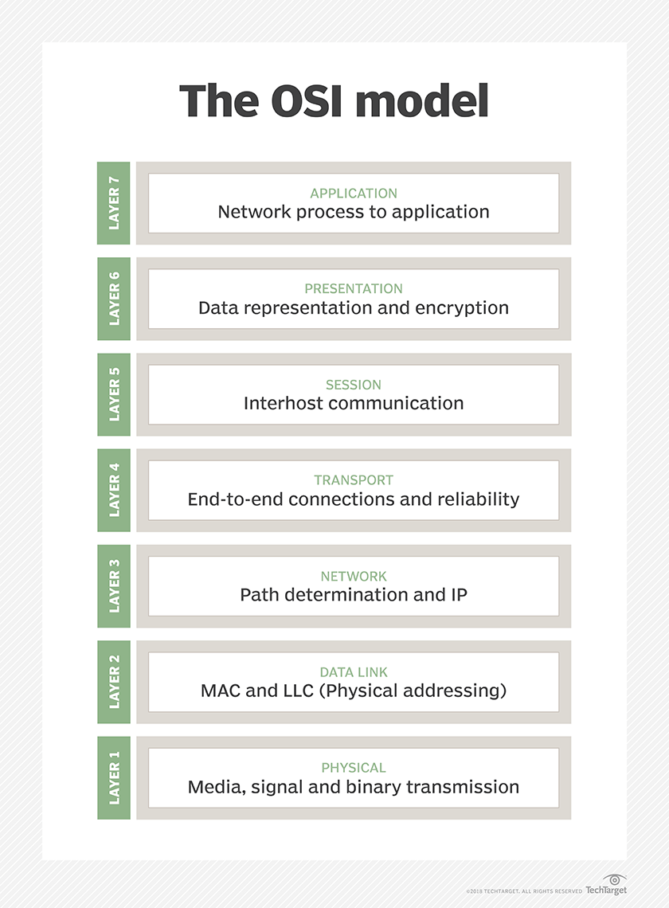
Where UDP enables process-to-process communication, TCP supports host-to-host communication. TCP sends individual packets and is considered a reliable transport medium; UDP sends messages, called datagrams, and is considered a best-effort mode of communications.
In addition, where TCP provides error and flow control, no such mechanisms are supported in UDP. UDP is considered a connectionless protocol because it doesn't require a virtual circuit to be established before any data transfer occurs.
UDP provides two services not provided by the IP layer. It provides port numbers to help distinguish different user requests and, optionally, a checksum capability to verify that the data arrived intact.

Slide 23
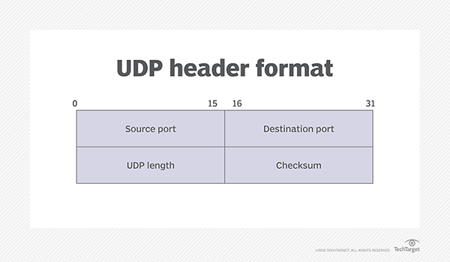
UDP header composition
The User Datagram Protocol header has four fields, each of which is 2 bytes. They are:
source port number, which is the number of the sender;
destination port number, the port the datagram is addressed to;
length, the length in bytes of the UDP header and any encapsulated data; and
checksum, which is used in error checking. Its use is required in IPv6 and optional in IPv4.

Slide 24
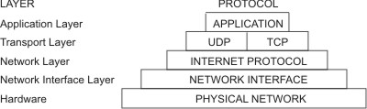
Internet apps: application, transport protocols
application
layer protocol
SMTP [RFC 2821]
Telnet [RFC 854]
HTTP [RFC 2616]
FTP [RFC 959]
HTTP (e.g., YouTube), RTP [RFC 1889]
SIP, RTP, proprietary
(e.g., Skype)
underlying
transport protocol
TCP
TCP
TCP
TCP
TCP or UDP
TCP or UDP
application
e-mail
remote terminal access
Web
file transfer
streaming multimedia
Internet telephony

Slide 25


Client-server architecture
server:
always-on host
permanent IP address
data centers for scaling
clients:
communicate with server
may be intermittently connected
may have dynamic IP addresses
do not communicate directly with each other
client/server

Slide 26
Client-server architecture

Slide 27
Service

Slide 28
Processes communicating
process: program running within a host
within same host, two processes communicate using inter-process communication (defined by OS)
processes in different hosts communicate by exchanging messages
clients, servers
client process: process that initiates communication
server process: process that waits to be contacted

Slide 29
Addressing processes
to receive messages, process must have identifier
host device has unique 32-bit IP address
Q: does IP address of host on which process runs suffice for identifying the process?
identifier includes both IP address and port numbers associated with process on host.
example port numbers:
HTTP server: 80
mail server: 25
to send HTTP message to gaia.cs.umass.edu web server:
IP address: 128.119.245.12
port number: 80
more shortly…
A: no, many processes can be running on same host

Slide 30
Internet adresses
octet 1
octet 2
octet 3
Range of addresses
Network ID
Host ID
1.0.0.0 to
Class A:
1 to 127
0 to 255
0 to 255
0 to 255
127.255.255.255
Network ID
Host ID
Class B:
128 to 191
0 to 255
0 to 255
0 to 255
128.0.0.0 to
191.255.255.255
Network ID
Host ID
Class C:
0 to 255
0 to 255
1 to 254
192.0.0.0 to
192 to 223
223.255.255.255
Multicast address
Class D (multicast):
224 to 239
0 to 255
0 to 255
1 to 254
224.0.0.0 to
239.255.255.255
Class E (reserved):
240 to 255
0 to 255
0 to 255
1 to 254
240.0.0.0 to
255.255.255.255

Slide 31
Domain name system
URL
http://www.cdk5.net:8888/WebExamples/earth.html
http://www.cdk3.net:8888/WebExamples/earth.html
DNS lookup
Resource ID (IP number, port number, pathname)
55.55.55.55
8888
WebExamples/earth.html
Web server
Network address
2:60:8c:2:b0:5a
file
2:60:8c:2:b0:5a
Socket
Instructor’s Guide for Coulouris, Dollimore, Kindberg and Blair, Distributed Systems: Concepts and Design Edn. 5 © Pearson Education 2012

Slide 32
DNS: a distributed, hierarchical database
Root DNS Servers
…
…
com DNS servers
org DNS servers
edu DNS servers
yahoo.com
DNS servers
pbs.org
DNS servers
poly.edu
DNS servers
umass.edu
DNS servers
amazon.com
DNS servers
client wants IP for www.amazon.com; 1st approx:
client queries root server to find com DNS server
client queries .com DNS server to get amazon.com DNS server
client queries amazon.com DNS server to get IP address for www.amazon.com

Slide 33
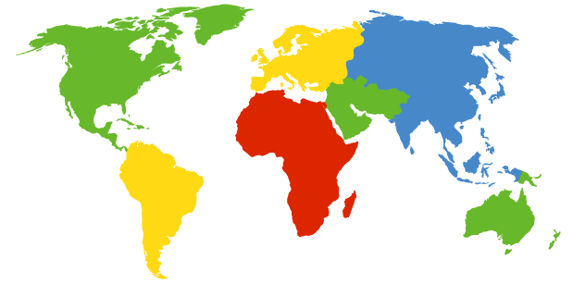
DNS: root name servers
contacted by local name server that can not resolve name
root name server:
contacts authoritative name server if name mapping not known
gets mapping
returns mapping to local name server
c. Cogent, Herndon, VA (5 other sites)
d. U Maryland College Park, MD
h. ARL Aberdeen, MD
j. Verisign, Dulles VA (69 other sites )
k. RIPE London (17 other sites)
i. Netnod, Stockholm (37 other sites)
e. NASA Mt View, CA
f. Internet Software C.
Palo Alto, CA (and 48 other sites)
m. WIDE Tokyo
(5 other sites)
13 root name “servers” worldwide
a. Verisign, Los Angeles CA
(5 other sites)
b. USC-ISI Marina del Rey, CA
l. ICANN Los Angeles, CA
(41 other sites)
g. US DoD Columbus, OH (5 other sites)

Slide 34
TLD, authoritative servers
top-level domain (TLD) servers:
responsible for com, org, net, edu, aero, jobs, museums, and all top-level country domains, e.g.: uk, fr, ca, jp
Network Solutions maintains servers for .com TLD
Educause for .edu TLD
authoritative DNS servers:
organization’s own DNS server(s), providing authoritative hostname to IP mappings for organization’s named hosts
can be maintained by organization or service provider

Slide 35
Local DNS name server
does not strictly belong to hierarchy
each ISP (residential ISP, company, university) has one
also called “default name server”
when host makes DNS query, query is sent to its local DNS server
has local cache of recent name-to-address translation pairs (but may be out of date!)
acts as proxy, forwards query into hierarchy

Slide 36
Web and HTTP
First, a review…
web page consists of objects
object can be HTML file, JPEG image, Java applet, audio file,…
web page consists of base HTML-file which includes several referenced objects
each object is addressable by a URL, e.g.,
www.someschool.edu/someDept/pic.gif
host name
path name

Slide 37
HTTP overview
HTTP: hypertext transfer protocol
Web’s application layer protocol
client/server model
client: browser that requests, receives, (using HTTP protocol) and “displays” Web objects
server: Web server sends (using HTTP protocol) objects in response to requests
HTTP request
PC running
Firefox browser
HTTP response
HTTP request
server
running
Apache Web
server
HTTP response
iphone running
Safari browser

Slide 38
HTTP request message
two types of HTTP messages: request, response
HTTP request message:
ASCII (human-readable format)
carriage return character
request line
(GET, POST,
HEAD commands)
line-feed character
GET /index.html HTTP/1.1\r\n
Host: www-net.cs.umass.edu\r\n
User-Agent: Firefox/3.6.10\r\n
Accept: text/html,application/xhtml+xml\r\n
Accept-Language: en-us,en;q=0.5\r\n
Accept-Encoding: gzip,deflate\r\n
Accept-Charset: ISO-8859-1,utf-8;q=0.7\r\n
Keep-Alive: 115\r\n
Connection: keep-alive\r\n
\r\n
header
lines
carriage return,
line feed at start
of line indicates
end of header lines

Slide 39
Uploading form input
POST method:
web page often includes form input
input is uploaded to server in entity body
URL method:
uses GET method
input is uploaded in URL field of request line:
www.somesite.com/animalsearch?monkeys&banana

Slide 40
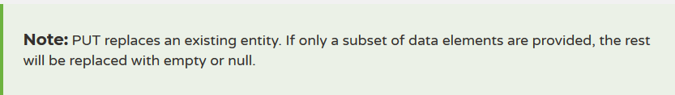
GET
Retrieve information. GET requests must be safe and idempotent, meaning regardless of how many times it repeats with the same parameters, the results are the same. They can have side effects, but the user doesn't expect them, so they cannot be critical to the operation of the system. Requests can also be partial or conditional.
POST
Request that the resource at the URI do something with the provided entity. Often POST is used to create a new entity, but it can also be used to update an entity.
PUT
Store an entity at a URI. PUT can create a new entity or update an existing one. A PUT request is idempotent. Idempotency is the main difference between the expectations of PUT versus a POST request.
HTTP status codes
Status codes indicate the result of the HTTP request.
1XX - informational
2XX - success
3XX - redirection
4XX - client error
5XX - server error
DELETE
Request that a resource be removed; however, the resource does not have to be removed immediately. It could be an asynchronous or long-running request.

Slide 41
Method types
HTTP/1.0:
GET
POST
HEAD
asks server to leave requested object out of response
HTTP/1.1:
GET, POST, HEAD
PUT
uploads file in entity body to path specified in URL field
DELETE
deletes file specified in the URL field

Slide 42
HTTP response message
status line
(protocol
status code
status phrase)
HTTP/1.1 200 OK\r\n
Date: Sun, 26 Sep 2010 20:09:20 GMT\r\n
Server: Apache/2.0.52 (CentOS)\r\n
Last-Modified: Tue, 30 Oct 2007 17:00:02 GMT\r\n
ETag: "17dc6-a5c-bf716880"\r\n
Accept-Ranges: bytes\r\n
Content-Length: 2652\r\n
Keep-Alive: timeout=10, max=100\r\n
Connection: Keep-Alive\r\n
Content-Type: text/html; charset=ISO-8859-1\r\n
\r\n
data data data data data ...
header
lines
data, e.g.,
requested
HTML file

Slide 43
HTTP response status codes
status code appears in 1st line in server-to-client response message.
some sample codes:
200 OK
request succeeded, requested object later in this msg
301 Moved Permanently
requested object moved, new location specified later in this msg (Location:)
400 Bad Request
request msg not understood by server
404 Not Found
requested document not found on this server
505 HTTP Version Not Supported

Slide 44
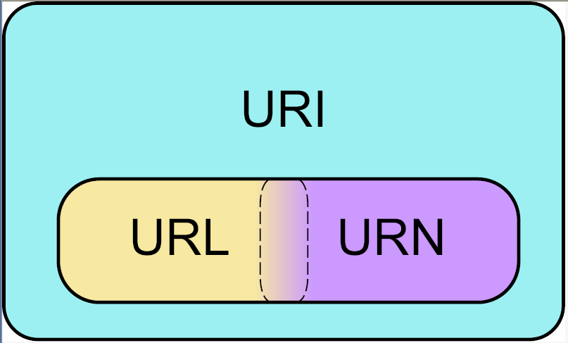
URI (Uniform Resource Identifier)
A Uniform Resource Identifier (URI) is a string of characters that unambiguously identifies a particular resource. To guarantee uniformity, all URIs follow a predefined set of syntax rules^{[1]}, but also maintain extensibility through a separately defined hierarchical naming scheme (e.g. "http://").
IETF URI Working Group http://www.ics.uci.edu/pub/ietf/uri/

Slide 45
Examples of URIs
http://www.feri.uni-mb.si/podrocje.aspx
ftp://ftp.feri.uni-mb.si
urn:issn:1535-3613

Slide 46
URN
Uniform resource name- URNs were originally conceived to be part of a three-part information architecture for the Internet, along with Uniform Resource Locators (URLs) and Uniform Resource Characteristics (URCs), a metadata framework. As described in the 1994 RFC 1737,^{[1]}, and later in the 1997 RFC 2141 ^{[2]}, URNs were distinguished from URLs, which identify resources by specifying their locations in the context of a particular access protocol, such as HTTP or FTP.
format: urn:<name space>:<name>
examples:
urn:ISBN:021-61918-0
b) urn:dcs.qmul.ac.uk:TR2000-56
*

Slide 47
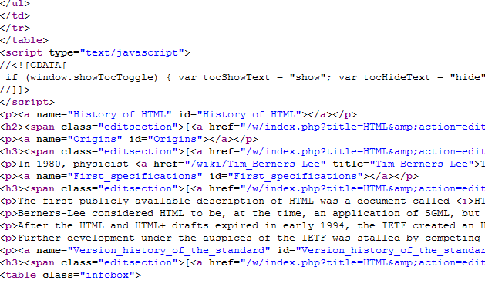
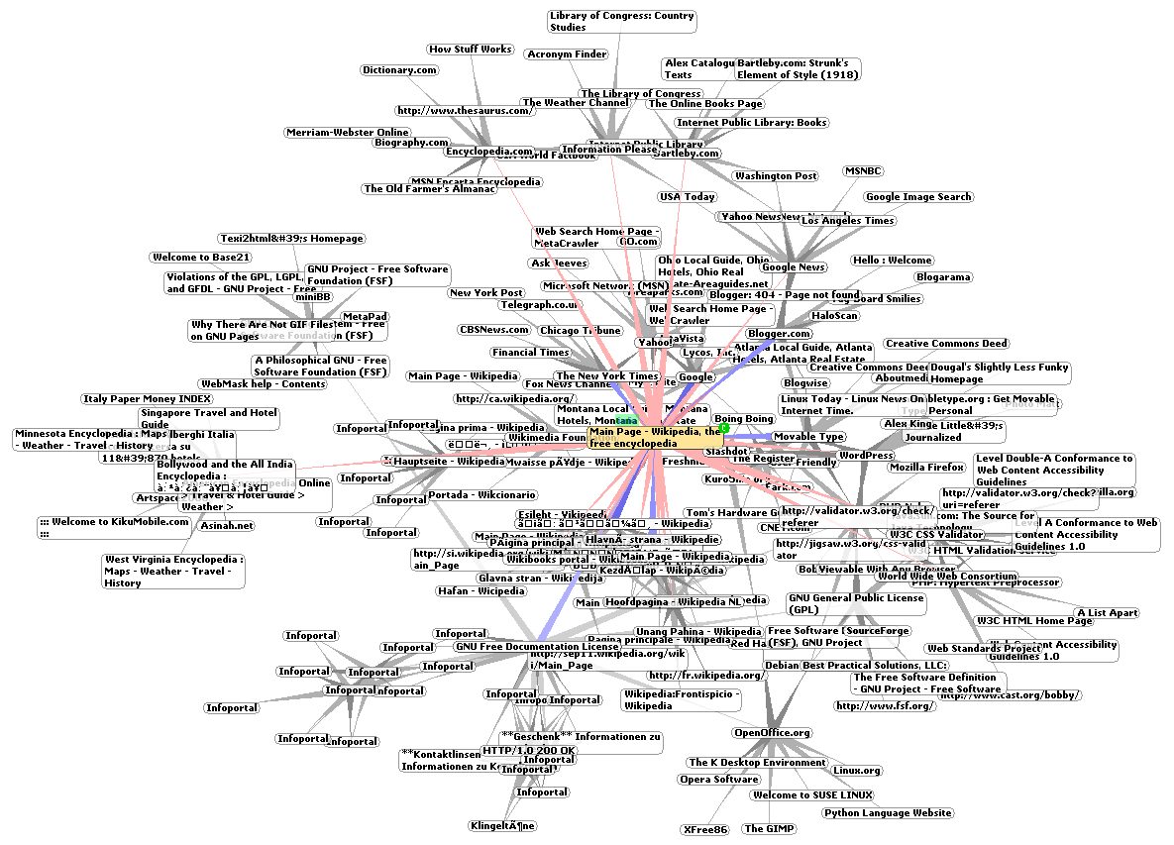
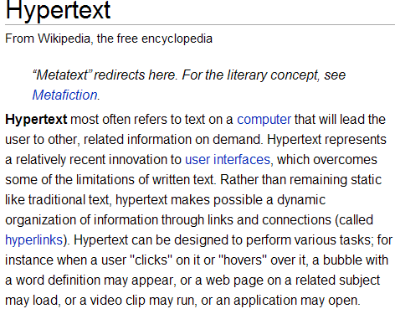
WWW (Word Wide Web)

Slide 48
How to search on the internet?
Guides – Tripadvisor
Search engines - Google, Bing
Metasearch engines MetaCrawler (http://www.metacrawler.com/ ), Ask.com (http://www.ask.com/ ).
Specialized search engines - Wolphram Alpha (http://www.wolframalpha.com/ )
Wikipedia list of search engines - https://en.wikipedia.org/wiki/List_of_search_engines
How to search on Google - https://support.google.com/websearch/answer/134479?hl=en

Slide 49
Network security
field of network security:
how bad guys can attack computer networks
how we can defend networks against attacks
how to design architectures that are immune to attacks
Internet not originally designed with (much) security in mind
original vision: “a group of mutually trusting users attached to a transparent network” ☺
Internet protocol designers playing “catch-up”
security considerations in all layers!

Slide 50
Bad guys: put malware into hosts via Internet
malware can get in host from:
virus: self-replicating infection by receiving/executing object (e.g., e-mail attachment)
worm: self-replicating infection by passively receiving object that gets itself executed
spyware malware can record keystrokes, web sites visited, upload info to collection site
infected host can be enrolled in botnet, used for spam. DDoS attacks
A botnet is a number of Internet-connected devices, each of which is running one or more bots. Botnets can be used to perform distributed denial-of-service attack (DDoS attack), steal data,[1] send spam, and allows the attacker to access the device and its connection. The owner can control the botnet using command and control (C&C) software.[2] The word "botnet" is a combination of the words "robot" and "network". The term is usually used with a negative or malicious connotation.

Slide 51
Bad guys: attack server, network infrastructure
Denial of Service (DoS): attackers make resources (server, bandwidth) unavailable to legitimate traffic by overwhelming resource with bogus traffic
A Denial-of-Service (DoS) attack is an attack meant to shut down a machine or network, making it inaccessible to its intended users. DoS attacks accomplish this by flooding the target with traffic, or sending it information that triggers a crash. In both instances, the DoS attack deprives legitimate users (i.e. employees, members, or account holders) of the service or resource they expected.
Victims of DoS attacks often target web servers of high-profile organizations such as banking, commerce, and media companies, or government and trade organizations. Though DoS attacks do not typically result in the theft or loss of significant information or other assets, they can cost the victim a great deal of time and money to handle. There are two general methods of DoS attacks: flooding services or crashing services. Flood attacks occur when the system receives too much traffic for the server to buffer, causing them to slow down and eventually stop.
1. select target
2. break into hosts around the network (see botnet)
3. send packets to target from compromised hosts
target

Slide 52
Bad guys can sniff packets
Web pages and emails are not sent through the internet intact as one document. Rather, the sending side (your computer) breaks them down into many little data packets. These packets are addressed to an IP address at the receiving end which usually has an obligation to acknowledge receipt of every packet it receives. In order to do support that, each packet contains the sending and receiving IP address as well as a lot of other information.
These packets do not get passed from the sender to the receiver in one fell swoop. Rather, each packet traverses the internet en-route to its destination by passing through a number of traffic control devices such as routers and switches. Each time a packet passes through one of these traffic control devices, it is susceptible to capture and analysis.
A
C
src:B dest:A payload
B
packet “sniffing”:
broadcast media (shared ethernet, wireless)
promiscuous network interface reads/records all packets (e.g., including passwords!) passing by
Wireshark software is a (free) packet-sniffer

Slide 53
Bad guys can use fake addresses
IP spoofing: send packet with false source address
A
C
src:B dest:A payload
B
IP Spoofing is a technique used to gain unauthorized access to machines, whereby an attacker illicitly impersonates another machine by manipulating IP packets. IP Spoofing involves modifying the packet header with a forged (spoofed) source IP address, a checksum, and the order value. Internet is a packet switched network, which causes the packets leaving one machine may be arriving at the destination machine in different order.

Slide 54
Principals
Autentication- process by which the identity of a subject is verified and must be performed in a secure fashion. Otherwise a perpetrator may impersonate others to gain access to the system. Typically involves the subject to demonstrate some form of evidence to prove its identity.( such as password or fingerprint or signed data using private key). Once authenticated, the subject is populated with associated identities or Principles(of type java.security.Principal). May have many Principles . For example, a person may have a name Principal ("John Doe") and an SSN Principal ("123-45-6789"), which distinguish it from other Subjects. (Who are you)
Authorization – process of gaining approval or permission on resources. (What rights you have?)- granting or denying access to a network resource. the user access to various resources based on the user's identity.
Digital signature-process that guarantees that the contents of msg have not been altered in transit. When you, the server, digitally sign a document, you add a one way hash (encryption) of the msg content using public and private key pair. Your client can still read it, but the process creates a “signature” that only the server public key can decrypt. The client using the servers; public key can then validate the sender as well as integrity of message contents.

Slide 55
Digital certificate- is used to encrypt online data/information communications between an end-users browser and a website. After veryfing that a company owns a website, certificate authority will sign their certificate so it is trusted by internet browsers. A Digital Certificate is an electronic "password" that allows a person, organizaion to exchange data securely over the Internet using the public key infrastructure (PKI). Digital Certificate is also known as a public key certificate or identity certificate.
Encription (HTTPS)- It means all communications between your browser and the website are encrypted. HTTPS is often used to protect highly confidential online transactions like online banking and online shopping order forms. HTTPS pages typically use one of two secure protocols to encrypt communications - SSL (Secure Sockets Layer) or TLS (Transport Layer Security). Both the TLS and SSL protocols use what is known as an 'asymmetric' Public Key Infrastructure (PKI) system. An asymmetric system uses two 'keys' to encrypt communications, a 'public' key and a 'private' key. Anything encrypted with the public key can only be decrypted by the private key and vice-versa.
The major benefits of a HTTPS certificate are:
Customer information, like credit card numbers, is encrypted and cannot be intercepted
Visitors can verify you are a registered business and that you own the domain
Customers are more likely to trust and complete purchases from sites that use HTTPS
Firewall- A firewall is a network security device that monitors incoming and outgoing network traffic and decides whether to allow or block specific traffic based on a defined set of security rules.
Firewalls have been a first line of defense in network security for over 25 years. They establish a barrier between secured and controlled internal networks that can be trusted and untrusted outside networks, such as the Internet.
A firewall can be hardware, software, or both.
Server configuration –
You use a server configuration file to configure the NATS server, including:
Client listening port
HTTP monitoring port
Client auth
Cluster definitions
Cluster routes
Logging
Max client connections
Max payload

Slide 56
OWASP Top ten
OWASP Top ten 2013
OWASP Top ten mobile applicatins 2016
OWASP Top ten 2017 RC2
OWASP Top ten Cheet Sheet
The Open Web Application Security Project, or OWASP, is an international non-profit organization dedicated to web application security. One of OWASP’s core principles is that all of their materials be freely available and easily accessible on their website, making it possible for anyone to improve their own web application security. The materials they offer include documentation, tools, videos, and forums. Perhaps their best-known project is the OWASP Top 10.

Slide 57
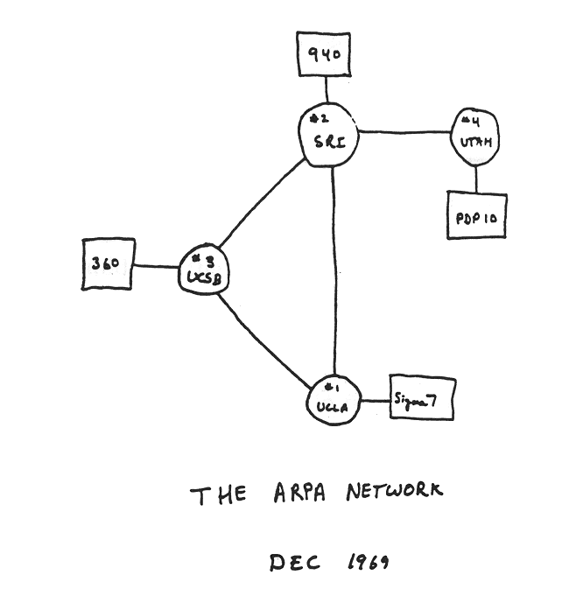
Internet history
1961-1972: Early packet-switching principles
1961: Kleinrock - queueing theory shows effectiveness of packet-switching
Leonard Kleinrock at MIT published the first paper on packet switching theory. Kleinrock convinced Roberts of the theoretical feasibility of communications using packets rather than circuits, which was a major step along the path towards computer networking. The other key step was to make the computers talk together.
1964: Baran - packet-switching in military nets
1967: ARPAnet conceived by Advanced Research Projects Agency
1969: first ARPAnet node operational
Due to Kleinrock's early development of packet switching theory and his focus on analysis, design and measurement, his Network Measurement Center at UCLA was selected to be the first node on the ARPANET.
1972:
ARPAnet public demo
NCP (Network Control Protocol) first host-host protocol
Network Working Group (NWG) working under S. Crocker finished the initial ARPANET Host-to-Host protocol, called the Network Control Protocol (NCP). As the ARPANET sites completed implementing NCP during the period 1971-1972, the network users finally could begin to develop applications.
first e-mail program
ARPAnet has 15 nodes

Slide 58
Internet history
1972-1980: Internetworking, new and proprietary nets
1970: ALOHAnet satellite network in Hawaii
1974: Cerf and Kahn - architecture for interconnecting networks
-The original Cerf/Kahn paper on the Internet described one protocol, called TCP, which provided all the transport and forwarding services in the Internet. Kahn had intended that the TCP protocol support a range of transport services, from the totally reliable sequenced delivery of data (virtual circuit model) to a datagram service in which the application made direct use of the underlying network service, which might imply occasional lost, corrupted or reordered packets.
1976: Ethernet at Xerox PARC
-Although Ethernet was under development at Xerox PARC at that time, the proliferation of LANs were not envisioned at the time, much less PCs and workstations. The original model was national level networks like ARPANET of which only a relatively small number were expected to exist. Thus a 32 bit IP address was used of which the first 8 bits signified the network and the remaining 24 bits designated the host on that network. This assumption, that 256 networks would be sufficient for the foreseeable future, was clearly in need of reconsideration when LANs began to appear in the late 1970s.
late70’s: proprietary architectures: DECnet, SNA, XNA
late 70’s: switching fixed length packets (ATM precursor)
1979: ARPAnet has 200 nodes
Cerf and Kahn’s internetworking principles:
minimalism, autonomy - no internal changes required to interconnect networks
best effort service model
stateless routers
decentralized control
define today’s Internet architecture

Slide 59
Internet history
1980-1990: new protocols, a proliferation of networks
1983: deployment of TCP/IP
1982: smtp e-mail protocol defined
Simple Mail Transfer Protocol- is TCP/IP protocol used in sending and receiving e-mail.Since it’s limited in its ability to queue msgs at the receiving end, it is usually used with one or two other protocols POP3, or IMAP.That let the user to save msgs in server mailbox.SMTP operates over Internet port 25.
1983: DNS defined for name-to-IP-address translation
new national networks: Csnet, BITnet, NSFnet, Minitel
100,000 hosts connected to confederation of networks
1985: FTP protocol defined –
File Transfer Protocol-File Transfer Protocol (FTP) is a client/server protocol used for transferring files to or exchanging files with a host computer. It may be authenticated with user names and passwords. Anonymous FTP allows users to access files, programs and other data from the Internet without the need for a user ID or password. Web sites are sometimes designed to allow users to use 'anonymous' or 'guest' as a user ID and an email address for a password. Publicly available flies are often found in a directory called pub and can be easily FTPed to a user’s computer. FTP is also the Internet standard for moving or transferring files from one computer to another using TCP or IP networks.
File Transfer Protocol is also known as RFC 959.
1988: TCP congestion control - Network congestion may occur when a sender overflows the network with too many packets. At the time of congestion, the network cannot handle this traffic properly, which results in a degraded quality of service (QoS). The typical symptoms of a congestion are: excessive packet delay, packet loss and retransmission.

Slide 60
Internet history
1990, 2000’s: commercialization, the Web, new apps
early 1990’s: ARPAnet decommissioned
1991: NSF lifts restrictions on commercial use of NSFnet (decommissioned, 1995)
early 1990s: Web
hypertext [Bush 1945, Nelson 1960’s]
HTML, HTTP: Berners-Lee
1994: Mosaic, later Netscape
late 1990’s: commercialization of the Web
late 1990’s – 2000’s:
XML, XHTML
more killer apps: instant messaging, P2P file sharing
network security to forefront
est. 50 million host, 100 million+ users
backbone links running at Gbps

Slide 61
Internet history
2005-present
~750 million hosts
Smartphones and tablets
Aggressive deployment of broadband access
Increasing ubiquity of high-speed wireless access
Emergence of online social networks:
Facebook: soon one billion users
Service providers (Google, Microsoft) create their own networks
Bypass Internet, providing “instantaneous” access to search, emai, etc.
E-commerce, universities, enterprises running their services in “cloud” (eg, Amazon EC2)

Slide 62
Important organizations
Internet Engineering Task Force (IETF) –-RFC standards http://www.ietf.org/
The Internet Society (ISOC) – advertising of Internet - http://www.isoc.org/
Internet Assigned Numbers Authority (IANA) - http://www.iana.org/
World Wide Web Consortium – https://www.w3.org/
European Computer Manufacturers Association (ECMA) - https://www.ecma-international.org/
OASIS - https://www.oasis-open.org/

